Slide 1
Computer Graphics Uniforms
László Szécsi szecsi@iit.bme.hu
AIT

Slide 2
Multiple objects
can we display the triangle, the star, and the heart at the same time?
easy, just draw them all after the program as been set
can we draw them at different positions, so that they do no overlap?
we could set their vertex positions in such a way…
but it is so much better if those positions are not baked in to the geometry

Slide 3
Vertex shader
.
The struct name is arbitrary (just as the uniform variable name is).
Here it is chosen to be gameObject
as it will need to be set differently for drawing all objects in the virtual world.
new uniform in vertex shader
just add gameObject.position to the vertex coordinates in the vertex shader
note vector operations are supported in GLSL
you can use the + or += operators on two vectors of equal element count
uniform struct{
vec3 position;
} gameObject;
gl_Position.xyz += gameObject.position;
first three elements as a vec3

Slide 4
Set value to GLSL uniform
!
set uniform before drawing object
but after selecting the shader program
reference to GPU memory
const objectPositionHandle =
gl.getUniformLocation(this.solidProgram.glProgram,
"gameObject.position");
if(objectPositionHandle === null) {
console.log("Could not find uniform: gameObject.position.");
} else {
gl.uniform3f(objectPositionHandle, 0.1, 0.1, 0.0);
}
experiment with numbers
WebGL method used needs to match uniform type (3f = three floats = vec3)

Slide 5

Normalized device coordinates (NDC)
the rasterizer interprets coordinates in this frame of reference
origin is viewport center
bottom left is (-1,-1)
top right is (1,1)
x increases left
y increases upwards
y
1
1
x
-1
-1

Slide 6
Draw multiple objects
!
call draw on any number of geometries any number of times
always setting the gameObject.position differently
note that you can draw multiple stars without the need to create additional resources
no new vertex or index buffers
no new geometry classes or objects
the same geometry can be drawn with different positions

Slide 7
Animation
we need to keep track of the position of one (or more) objects
change the position in every frame
use current position to set uniform, when drawing said object

Slide 8
New member in Scene: avatarPosition
.
in JS, you just assign a value (typically, in the constructor) to add member (property)
change this.avatarPosition in every frame
this.avatarPosition = {x:0, y:0, z:0};
this.avatarPosition.x += 0.1;

Slide 9
Copy JS property value to GLSL uniform – not automatic! (yet?)
!
set uniform before drawing
but after selecting the shader program
const objectPositionHandle =
gl.getUniformLocation(this.solidProgram.glProgram,
"gameObject.position");
if(objectPositionHandle === null) {
console.log("Could not find uniform: gameObject.position.");
} else {
gl.uniform3f(objectPositionHandle,
this.avatarPosition.x,
this.avatarPosition.y,
this.avatarPosition.z);
}

Slide 10
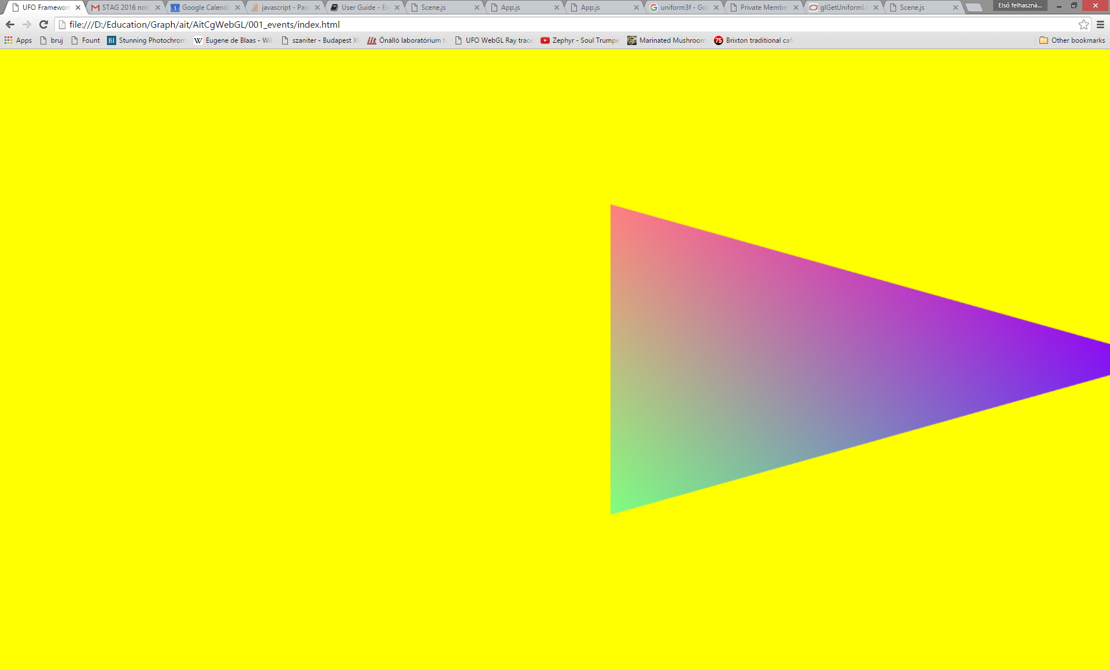
Result: motion

Slide 11
Make velocity constant on all computers!
!
let us compute the time step and apply motion proportionally
distance travelled = velocity * time elapsed
result: consistent motion ☺
//in constructor:
this.timeAtFirstFrame = new Date().getTime();
this.timeAtLastFrame = this.timeAtFirstFrame;
const timeAtThisFrame = new Date().getTime();
const dt = (timeAtThisFrame - this.timeAtLastFrame) / 1000.0;
this.timeAtLastFrame = timeAtThisFrame;
this.avatarPosition.x += 0.1 * dt;

Slide 12
Further tasks I
!
make escaped avatar wrap around
make objects different size
introduce uniform gameObject.scale, multiply x, y, z coordinates with it in VS

Slide 13
Further tasks II
!
make triangles shrink and grow
use a sine function of current time to set the avatarScale
figure out how to turn a triangle 90 degrees in the vertex shader
const t = (timeAtThisFrame - this.timeAtFirstFrame) / 1000.0;
this.avatarScale.x = Math.sin(t);

Slide 14
Move triangle with keys
!
make motion conditional on a property of keysPressed
need to pass this.keyPressed from App update to Scene update as a parameter
take the parameter in Scene update and use it to make motion conditional
you can access properties using the syntax: keysPressed.SPACE or keysPressed["SPACE"]

